Slide 1
Module 2 - Linear Data Structures

Slide 2
What is Data?
Data is the basic fact or entity that is utilized in calculation or manipulation.
There are two different types of data Numeric data and Alphanumeric data.
When a programmer collects such type of data for processing, he would require to store them in computer’s main memory.
The process of storing data items in computer’s main memory is called representation.
Data to be processed must be organized in a particular fashion, these organization leads to structuring of data, and hence the mission to study the Data Structures.

Slide 3

What is Data Structure?
Data Structure is a representation of the logical relationship existing between individual elements of data.
In other words, a data structure is a way of organizing all data items that considers not only the elements stored but also their relationship to each other.
We can also define data structure as a mathematical or logical model of a particular organization of data items.
Data Structure mainly specifies the following four things
Organization of Data
Accessing Methods
Degree of Associativity
Processing alternatives for information

Slide 4
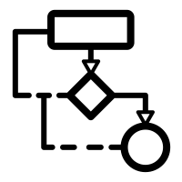

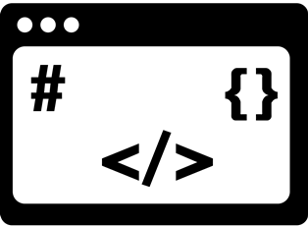
Cont..
The representation of a particular data structure in the memory of a computer is called Storage Structure.
The storage structure representation in auxiliary memory is called as File Structure.
Algorithm
Data Structure
Program

Slide 5
Classification of Data Structure
Data Structure
Primitive Data Structure
Non-Primitive Data Structure
Integer
Characters
Arrays
Lists
Files
Floating
Point
Pointers
Linear List
Non-linear List
Stack
Queue
Graphs
Trees

Slide 6
Primitive / Non-primitive data structures
Primitive data structures
Primitive data structures are basic structures and are directly operated upon by machine instructions.
Integers, floats, character and pointers are examples of primitive data structures.
Non primitive data structure
These are derived from primitive data structures.
The non-primitive data structures emphasize on structuring of a group of homogeneous or heterogeneous data items.
Examples of Non-primitive data type are Array, List, and File.

Slide 7
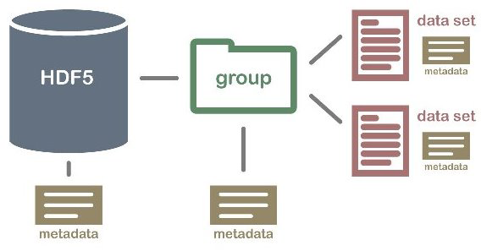
Non primitive Data Structure
Array: An array is a fixed-size sequenced collection of elements of the same data type.
List: An ordered set containing variable number of elements is called as Lists.
File: A file is a collection of logically related information. It can be viewed as a large list of records consisting of various fields.
Array
File
List

Slide 8
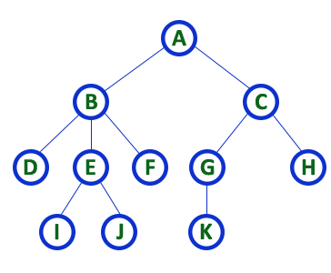
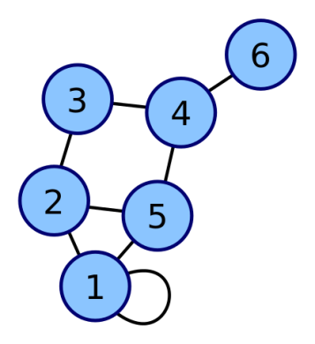
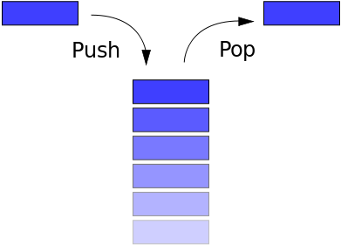
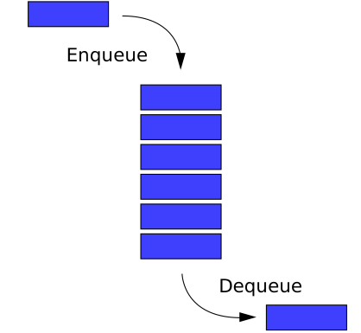
Linear / Non-Linear data structure
Linear data structures
A data structure is said to be Linear, if its elements are connected in linear fashion by means of logically or in sequence memory locations.
Examples of Linear Data Structure are Stack and Queue.
Nonlinear data structures
Nonlinear data structures are those data structure in which data items are not arranged in a sequence.
Examples of Non-linear Data Structure are Tree and Graph.
Stack
Queue
Tree
Graph

Slide 9
Operations of Data Structure
Create: It results in reserving memory for program elements.
Destroy: It destroys memory space allocated for specified data structure.
Selection: It deals with accessing a particular data within a data structure.
Updation: It updates or modifies the data in the data structure.
Searching: It finds the presence of desired data item in the list of data items.
Sorting: It is a process of arranging all data items in a data structure in a particular order.
Merging: It is a process of combining the data items of two different sorted list into a single sorted list.
Splitting: It is a process of partitioning single list to multiple list.
Traversal: It is a process of visiting each and every node of a list in systematic manner.

Slide 10
Time and space analysis of algorithms
Sometimes, there are more than one way to solve a problem.
We need to learn how to compare the performance of different algorithms and choose the best one to solve a particular problem.
While analyzing an algorithm, we mostly consider time complexity and space complexity.
Time complexity of an algorithm quantifies the amount of time taken by an algorithm to run as a function of the length of the input.
Space complexity of an algorithm quantifies the amount of space or memory taken by an algorithm to run as a function of the length of the input.
Time & space complexity depends on lots of things like hardware, operating system, processors, etc.
However, we don't consider any of these factors while analyzing the algorithm. We will only consider the execution time of an algorithm.

Slide 11
Calculate Time Complexity of Algorithm
Time Complexity is most commonly estimated by counting the number of elementary functions performed by the algorithm.
Since the algorithm's performance may vary with different types of input data,
hence for an algorithm we usually use the worst-case Time complexity of an algorithm because that is the maximum time taken for any input size.

Slide 12
Calculating Time Complexity
Calculate Time Complexity of Sum of elements of List (One dimensional Array)
A is array, n is no of elements in array
SumOfList(A,n)
{
Line 1 total = 0
Line 2 for i = 0 to n-1
Line 3 total = total + A[i]
Line 4 return total
}
Line
Cost
No of Times
1
1
1
2
2
n + 1
3
2
n
4
1
1
TSumOfList = 1 + 2 (n+1) + 2n + 1
= 4n + 4
We can neglate constant 4
= n
Time complexity of given algorithm is n unit time

Slide 13
Stack
A linear list which allows insertion and deletion of an element at one end only is called stack.
The insertion operation is called as PUSH and deletion operation as POP.
The most accessible elements in stack is known as top.
The elements can only be removed in the opposite orders from that in which they were added to the stack.
Such a linear list is referred to as a LIFO (Last In First Out) list.
Deletion
Insertion
C
…
…
B
A
TOP

Slide 14
Stack Cont…
A pointer TOP keeps track of the top element in the stack.
Initially, when the stack is empty, TOP has a value of “zero”.
Each time a new element is inserted in the stack, the pointer is incremented by “one” before, the element is placed on the stack.
The pointer is decremented by “one” each time a deletion is made from the stack.

Slide 15
Applications of Stack
Recursion
Keeping track of function calls
Evaluation of expressions
Reversing characters
Servicing hardware interrupts
Solving combinatorial problems using backtracking
Expression Conversion (Infix to Postfix, Infix to Prefix)
Game Playing (Chess)
Microsoft Word (Undo / Redo)
Compiler – Parsing syntax & expression
Finding paths

Slide 16
Procedure : PUSH (S, TOP, X)
This procedure inserts an element X to the top of a stack.
Stack is represented by a vector S containing N elements.
A pointer TOP represents the top element in the stack.
1. [Check for stack overflow]
If TOP ≥ N
Then write (‘STACK OVERFLOW’)
Return
2. [Increment TOP]
TOP ← TOP + 1
3. [Insert Element]
S[TOP] ← X
4. [Finished]
Return
Stack is empty, TOP = 0, N=3
TOP = 3
-5
TOP = 2
8
PUSH(S, TOP, 10)
TOP = 1
10
S
PUSH(S, TOP, 8)
PUSH(S, TOP, -5)
PUSH(S, TOP, 6)
Overflow

Slide 17
Function : POP (S, TOP)
This function removes & returns the top element from a stack.
Stack is represented by a vector S containing N elements.
A pointer TOP represents the top element in the stack.
1. [Check for stack underflow]
If TOP = 0
Then write (‘STACK UNDERFLOW’)
Return (0)
2. [Decrement TOP]
TOP ← TOP - 1
3. [Return former top element of stack]
Return(S[TOP + 1])
POP(S, TOP)
TOP = 3
-5
TOP = 2
8
TOP = 1
10
POP(S, TOP)
TOP = 0
S
POP(S, TOP)
POP(S, TOP)
Underflow

Slide 18
Polish Expression & their Compilation
Evaluating Infix Expression
a + b * c + d * e
1
2
3
4
A repeated scanning from left to right is needed as operators appears inside the operands.
Repeated scanning is avoided if the infix expression is first converted to an equivalent parenthesis free prefix or suffix (postfix) expression.
Prefix Expression: Operator, Operand, Operand
Postfix Expression: Operand, Operand, Operator

Slide 19
Polish Notation
This type of notation is known Lukasiewicz Notation or Polish Notation or Reverse Polish Notation due to Polish logician Jan Lukasiewicz.
In both prefix and postfix equivalents of an infix expression, the variables are in same relative position.
The expressions in postfix or prefix form are parenthesis free and operators are rearranged according to rules of precedence for operators.

Slide 20
Polish Notation
Sr. | Infix | Postfix | Prefix
1 | a
2 | a + b
3 | a + b + c
4 | a + (b + c)
5 | a + (b * c)
6 | a * (b + c)
7 | a * b * c
a
a
a b +
+ a b
a b + c +
+ + a b c
a b c + +
+ a + b c
a b c * +
+a * b c
a b c + *
* a + b c
a b *c*
** a b c
a + b + c
a + b + c
(ab+)+ c
(ab+) c +
a b + c +

Slide 21
Convert Infix to Postfix Expression
Symbol | Input precedence function (F) | Stack precedence function (G) | Rank function (R)
+, - | 1 | 2 | -1
*, / | 3 | 4 | -1
^ | 6 | 5 | -1
Variables | 7 | 8 | 1
( | 9 | 0 | -
) | 0 | - | -

Slide 22
Infix to Postfix Conversion
Scan the infix expression from left to right.
If the scanned character is an operand, put it in the postfix expression.
Otherwise, do the following
If the precedence and associativity of the scanned operator are greater than the precedence and associativity of the operator in the stack [or the stack is empty or the stack contains a ‘(‘ ], then push it in the stack. [‘^‘ operator is right associative and other operators like ‘+‘,’–‘,’*‘ and ‘/‘ are left-associative].
Check especially for a condition when the operator at the top of the stack and the scanned operator both are ‘^‘. In this condition, the precedence of the scanned operator is higher due to its right associativity. So it will be pushed into the operator stack.
In all the other cases when the top of the operator stack is the same as the scanned operator, then pop the operator from the stack because of left associativity due to which the scanned operator has less precedence.
Else, Pop all the operators from the stack which are greater than or equal to in precedence than that of the scanned operator.
After doing that Push the scanned operator to the stack. (If you encounter parenthesis while popping then stop there and push the scanned operator in the stack.)

Slide 23
Cont.,
If the scanned character is a ‘(‘, push it to the stack.
If the scanned character is a ‘)’, pop the stack and output it until a ‘(‘ is encountered, and discard both the parenthesis.
Repeat steps 2-5 until the infix expression is scanned.
Once the scanning is over, Pop the stack and add the operators in the postfix expression until it is not empty.
Finally, print the postfix expression.

Slide 24
Evaluating Postfix Expression
Follow the steps mentioned below to evaluate postfix expression using stack:
Create a stack to store operands (or values).
Scan the given expression from left to right and do the following for every scanned element.
If the element is a number, push it into the stack.
If the element is an operator, pop operands for the operator from the stack. Evaluate the operator and push the result back to the stack.
When the expression is ended, the number in the stack is the final answer.

Slide 25
Input Symbol | Content of stack | Reverse polish expression | Rank
( a + b ^ c ^ d ) * ( e + f / d ) )
(
0
NEXT
(
1. [Initialize Stack]
TOP ← 1
S[TOP] ← ‘(’
2. [Initialize output string and rank count]
POLISH ← ‘’
RANK ← 0
3. [Get first input symbol]
NEXT ← NEXTCHAR(INFIX)

Slide 26
( a + b ^ c ^ d ) * ( e + f / d ) )
Input Symbol | Content of stack | Reverse polish expression | Rank
(
0
NEXT
(
((
0
4. [Translate the infix expression]
Repeat thru step 7
while NEXT!= ‘ ‘
a
((a
0
+
((+
((
a
1
5. [Remove symbols with greater precedence from stack]
IF TOP < 1
Then write (‘INVALID’)
EXIT
Repeat while G(S[TOP]) > F(NEXT)
TEMP ← POP (S, TOP)
POLISH ← POLISH O TEMP
RANK ← RANK + R(TEMP)
IF RANK <1
Then write (‘INVALID’)
EXIT
b
((+b
a
1
((+
ab
^
((+^
2
c
((+^c
ab
2
((+^^
abc
^
((+^
3
d
((+^^d
abc
3
((
abcd^^+
)
(
1
6. [Are there matching parentheses]
IF G(S[TOP]) != F(NEXT)
Then call PUSH (S,TOP, NEXT)
Else POP (S,TOP)
7. [Get next symbol]
NEXT ← NEXTCHAR(INFIX)

Slide 27
General Infix-to-Postfix Conversion
Create an empty stack called stack for keeping operators. Create an empty list for output.
Read the character list from left to right and perform following steps
1
If the character is an operand (Variable), append it to the end of the output list
2
If the character is a left parenthesis ‘(’, push it on the stack
3
If the character is a right parenthesis ‘)’, pop the stack until the corresponding left parenthesis ‘)’ is removed. Append each operator to the end of the output list.
4
If the token is an operator, *, /, +, or -, push it on the stack. However, first remove any operators already on the stack that have higher or equal precedence and append them to the output list.
( a + b ^ c ^ d ) * ( e + f / d )

Slide 28
Evaluation of postfix expression
Each operator in postfix string refers to the previous two operands in the string.
Each time we read an operand, we PUSH it onto Stack.
When we reach an operator, its operands will be top two elements on the stack.
We can then POP these two elements, perform the indicated operation on them and PUSH the result on the stack so that it will available for use as an operand for the next operator.

Slide 29
Evaluation of postfix expression
Evaluate Expression: 5 6 2 - +
Empty Stack
Read – , is it operator? POP two symbols and perform operation and PUSH result
Read 5, is it operand? PUSH
Read 6, is it operand? PUSH
2
Read 2, is it operand? PUSH
6
4
5
–
5
Operand 1
Operand 2
Read + , is it operator? POP two symbols and perform operation and PUSH result
Read next symbol, if it is end of string, POP answer from Stack
Answer
9
+
Operand 1
Operand 2

Slide 30
Algorithm: EVALUATE_POSTFIX
Given an input string POSTFIX representing postfix expression.
This algorithm evaluates postfix expression and put the result into variable VALUE.
Stack is represented by a vector S, TOP denotes the top of the stack, Algorithm PUSH and POP are used for stack manipulation.
Function NEXTCHAR returns the next symbol in given input string.
OPERAND1, OPERAND2 and TEMP are used for temporary variables
PERFORM_OPERATION is a function which performs required operation on OPERAND1 & OPERAND2.

Slide 31
Algorithm: EVALUATE_POSTFIX
1. [Initialize Stack]
TOP ← 0
VALUE ← 0
2. [Evaluate the postfix expression]
Repeat until last character
TEMP ← NEXTCHAR (POSTFIX)
If TEMP is DIGIT
Then PUSH (S, TOP, TEMP)
Else OPERAND2 ← POP (S, TOP)
OPERAND1 ← POP (S, TOP)
VALUE ← PERFORM_OPERATION(OPERAND1, OPERAND2, TEMP)
PUSH (S, POP, VALUE)
3. [Return answer from stack]
Return (POP (S, TOP))

Slide 32
Algorithm: EVALUATE_PREFIX
Given an input string PREFIX representing prefix expression.
This algorithm evaluates prefix expression and put the result into variable VALUE.
Stack is represented by a vector S, TOP denotes the top of the stack, Algorithm PUSH and POP are used for stack manipulation.
Function NEXTCHAR returns the next symbol in given input string.
OPERAND1, OPERAND2 and TEMP are used for temporary variables
PERFORM_OPERATION is a function which performs required operation on OPERAND1 & OPERAND2.

Slide 33
Algorithm: EVALUATE_PREFIX
1. [Initialize Stack]
TOP ← 0
VALUE ← 0
2. [Evaluate the prefix expression]
Repeat from last character up to first
TEMP ← NEXTCHAR (PREFIX)
If TEMP is DIGIT
Then PUSH (S, TOP, TEMP)
Else OPERAND1 ← POP (S, TOP)
OPERAND2 ← POP (S, TOP)
VALUE ← PERFORM_OPERATION(OPERAND1, OPERAND2, TEMP)
PUSH (S, POP, VALUE)
3. [Return answer from stack]
Return (POP (S, TOP))

